Slide 1
Blockchain in gaming
Prajapati Praveen : 240160510037
Desai Manish : 240160510008

Slide 2
1. What is Blockchain Gaming?
Blockchain gaming (often called GameFi) is the integration of blockchain technology with games.
Players own in-game assets (weapons, skins, land, characters) as tokens on a blockchain.
Assets can be fungible tokens (currencies) or NFTs (unique items).
Games often use a play-to-earn (P2E) or play-and-own model, rewarding players with crypto or NFTs.

Slide 3
Major Difference Between Fungible Tokens and NFTs
Aspect | Fungible Tokens (FTs) | Non-Fungible Tokens (NFTs)
Definition | Identical, interchangeable, digital assets. | Unique digital assets with distinct properties.
Example (crypto) | ETH, BTC, USDT, PIXEL. | CryptoPunk #123, Bored Ape #7777, a piece of game land.
Divisibility | Can be split into smaller units (e.g., 0.01 ETH). | Usually indivisible (you can’t “half own” an NFT, unless fractionalized).
Value | Each token has the same value as another of the same type. (1 USDT = 1 USDT). | Each NFT has different value based on rarity.
Use cases | Currency, governance tokens, staking rewards. | Art, gaming items, land, collectibles, identity, certificates.

Slide 4
In short:
Fungible tokens = money-like (interchangeable, uniform).
NFTs = property-like (unique, individual).
CryptoPunk-Some traits are extremely rare (e.g., only 9 Aliens, 24 Apes, 88 Zombies).
NFT use cases
1. Art
How it works: Artists mint digital artworks as NFTs .
Each token represents ownership of that artwork.
Why NFTs help:
Proof of authenticity (no forgery — blockchain verifies original artist).
Royalties: Smart contracts can pay the artist automatically each time the NFT is resold.

Slide 5
2. Gaming Items
How it works: In blockchain games, weapons, skins, pets, or characters can be NFTs. Players own them in their wallets, not just inside the game’s servers.
Why NFTs help:
True ownership: You can sell or trade your sword/skin outside the game.
Interoperability: Some items may move between games in the same ecosystem.

Slide 6
Core Elements
Fungible Tokens
Used as in-game currencies or governance tokens.
Example: AXS (Axie Infinity Shards), PIXEL, SAND (The Sandbox).
NFTs
Represent unique game assets like skins, pets, land.
Example: Axies in Axie Infinity, plots in Decentraland, avatars in Pixels.
Smart Contracts
Automate rules (staking, battles, trading, reward distribution).
Marketplaces
In-game items can be traded freely on platforms like OpenSea, Magic Eden, or built-in game markets.
Wallets
Players need crypto wallets (e.g., MetaMask, Ronin Wallet) to store assets and interact with the game.

Slide 7
Benefits of Blockchain in Gaming
True Ownership: Players actually own items, not just “licensed use.”
Interoperability: Assets may move across games or metaverses.
Play-to-Earn: Players earn tokens/NFTs that can be sold for real money.
Transparency: Blockchain provides fair and open proof of rarity, drop rates, and trades.
Community Governance: Token holders vote on updates, economy changes, and policies.

Slide 8
Popular Models
Play-to-Earn (P2E)
Players earn tokens through gameplay.
Example: Axie Infinity.
Play-and-Own
Focus on fun; earning is secondary. Assets retain resale value.
Example: Pixels.
Metaverse / Virtual Worlds
Virtual land + digital economies.
Example: The Sandbox, Decentraland.
Move-to-Earn / Create-to-Earn
Extends into fitness or content creation.
Example: StepN (running), music/game NFTs.

Slide 9
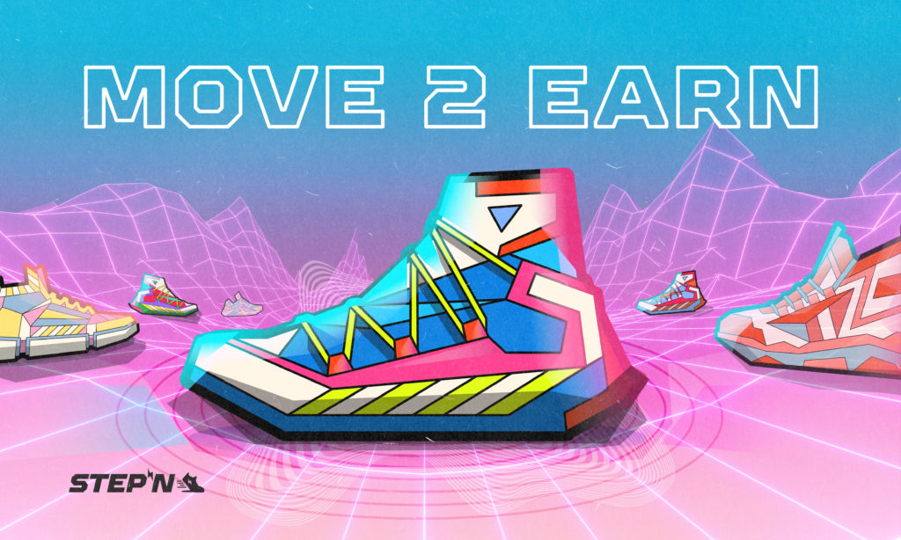
StepN(Move-to-Earn)Project

Slide 10
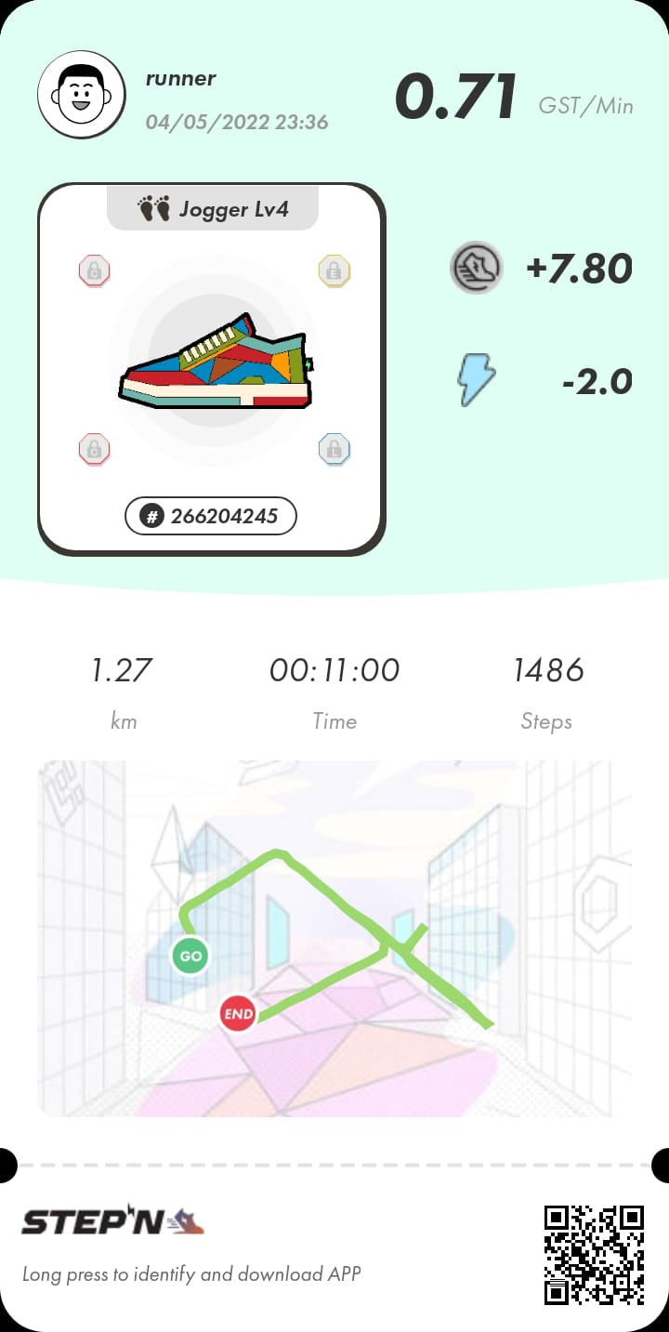
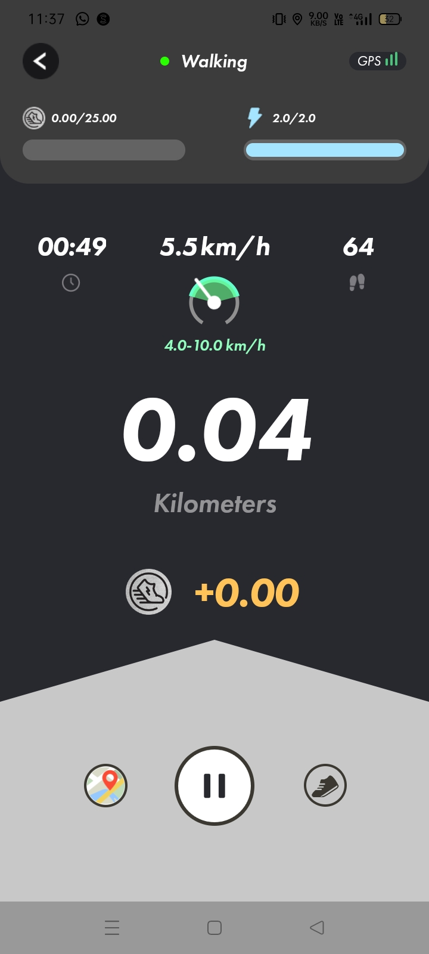
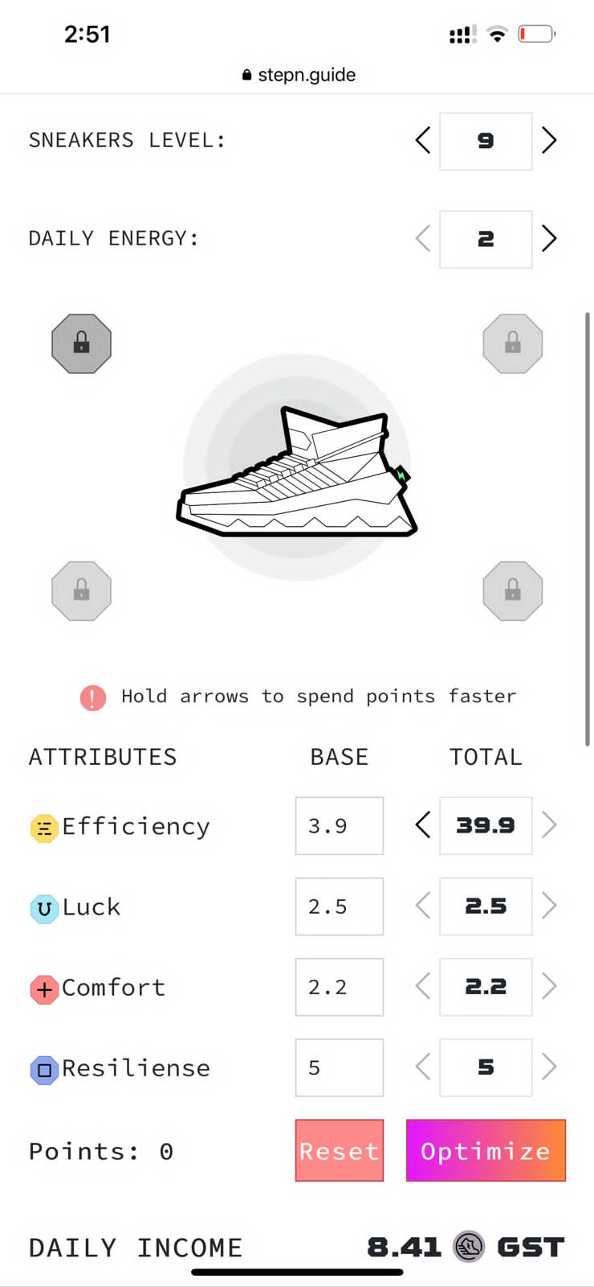

Slide 11
